Slide 1
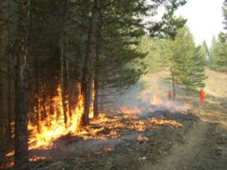
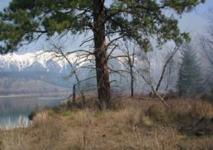
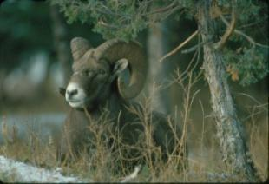
British Columbia
Ecosystem Restoration Program

Slide 2
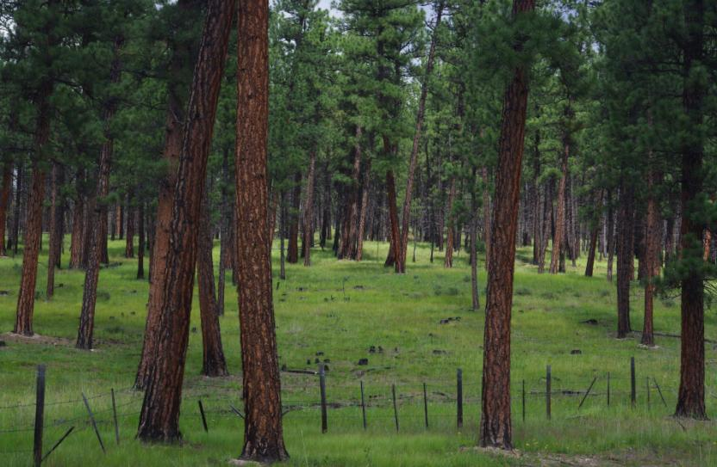
Al Neal, P.Ag. RFT
British Columbia
Senior Ecosystem Restoration Specialist
Co-Chair, BC Prescribed Fire Council

Slide 3
Presentation focus
BC Ecosystem Restoration 101
Controlled burning on the landscape
ER and lessons learned

Slide 4
95Mha
62Mha
38Mha
0.2Mha
24Mha
Annual ER treatment
0.004 Mha
(4,000 ha)
Annual harvest area
Timber harvest land base
Non-timber harvest land base

Slide 5
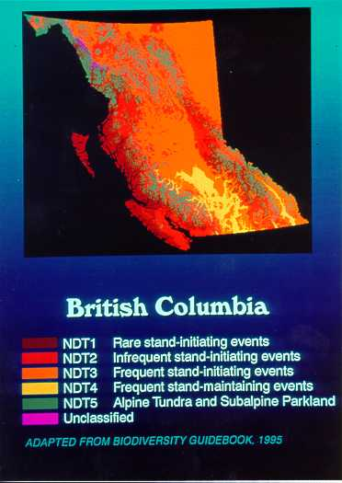
BC’s Fire- Maintained Ecosystem

Slide 6
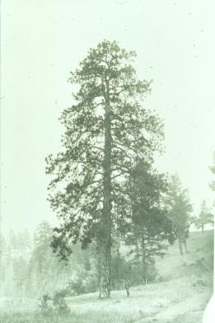
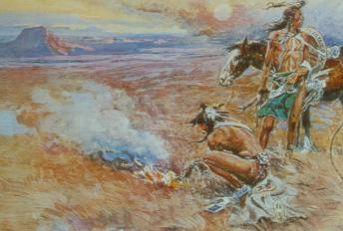
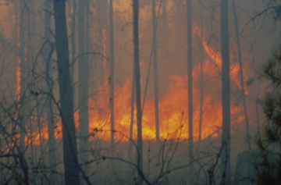
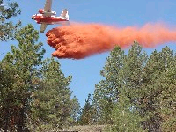
Fire Maintained History
Pre - 1880 fires
1880 disruption of frequent low-intensity fires
1920’s & 1930’s high intensity wildfires
1940’s to present fire suppression era

Slide 7
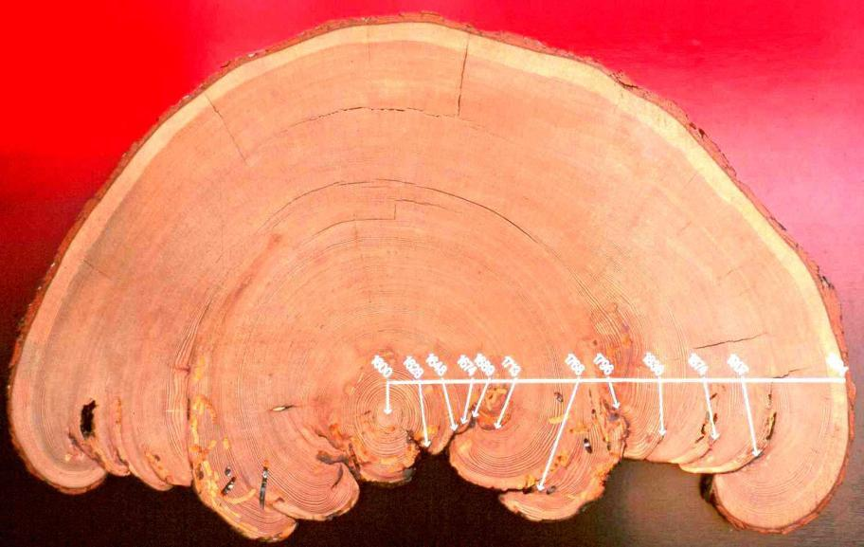
400 year old western larch from Rocky Mountain Trench showing 10 fire scars between 1628 and 1907 (~28 year interval)

Slide 8
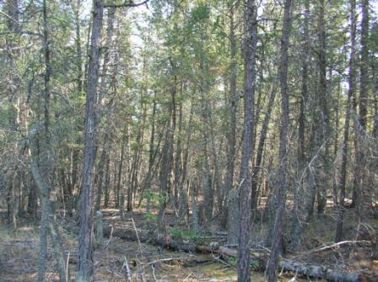
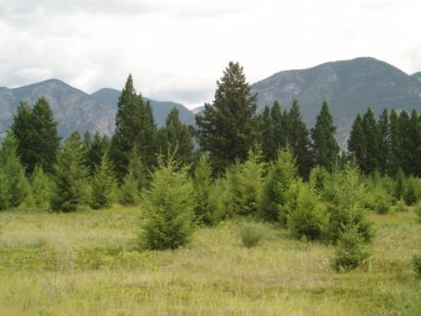
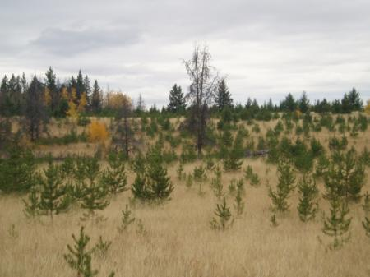
The issues in the fire-maintained....
“ingrown” open forests (up to 100,000+ stems/ha) & native grassland “encroachment”

Slide 9
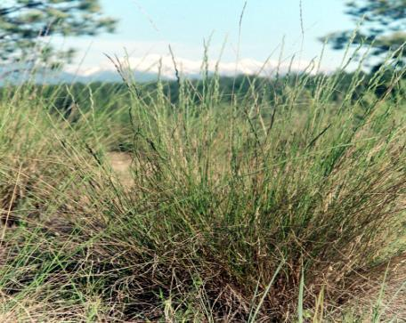
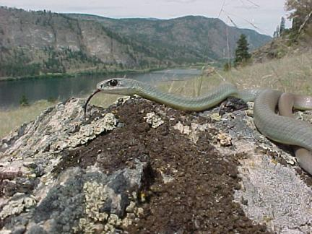
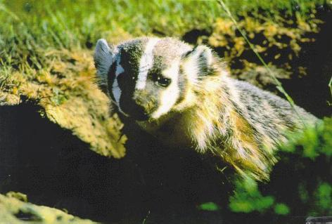
Disappearing native grasslands……
(<1% of BC’s land base is remaining native grassland while ~30% of at-risk species in province are grassland dependent!)
Bluebunch wheatgrass – an imperilled grassland species
Racer Snake – blue-listed grassland species
Badger – a red-listed grassland species
Notes:
In 2011-12 ER prescriptions wrote in specific considerations for different red and blue listed species including 49 fauna and 60 flora species.

Slide 10
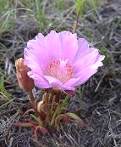
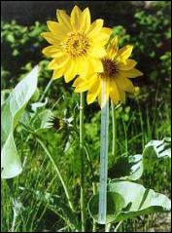
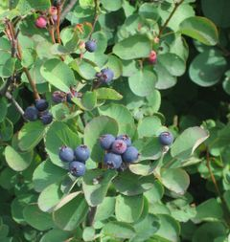
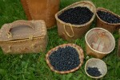
Loss of First Nation cultural values
Bitterroot
Saskatoon
Balsamroot
Matthew Jacob

Slide 11
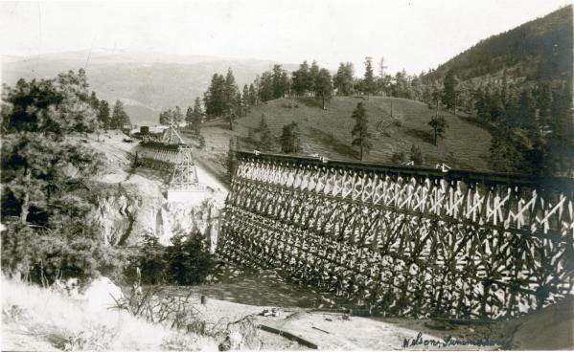
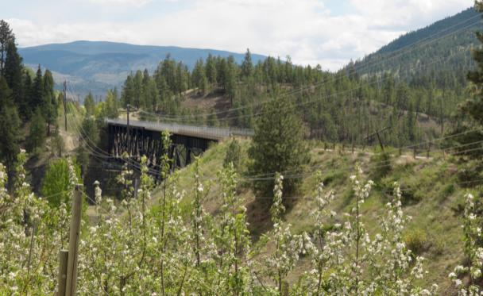
Trout Creek Bridge 1910
Trout Creek Bridge 2009

Slide 12
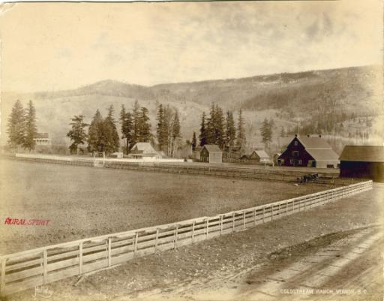
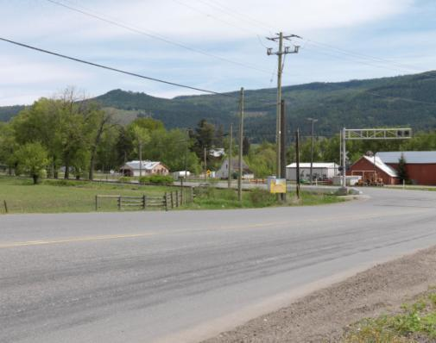
Cold Stream Ranch, Vernon 189-
BC Archives
Cold Stream Ranch 2009

Slide 13
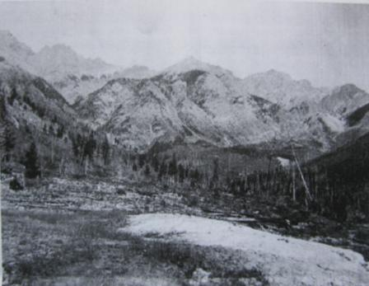
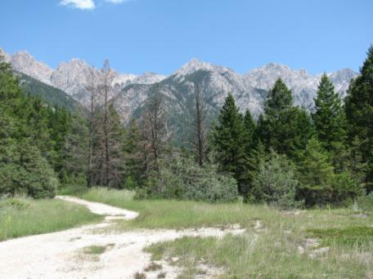
Fairmont Hot Springs circa 1900 and 2009
Notes:
Insert pictures of historic openness

Slide 14
Cariboo-Chilcotin

Slide 15
Okanagan

Slide 16
Taking Nature’s Pulse
The status of Biodiversity in BC, 2008
At the broad scale, four biogeoclimatic zones:
  Coastal Douglas-fir
  Interior Douglas-fir
  Ponderosa Pine
  Bunchgrass
  Representing approximately 5% of British Columbia's land base, are of provincial conservation concern (critically imperilled, imperilled or vulnerable).

Slide 17
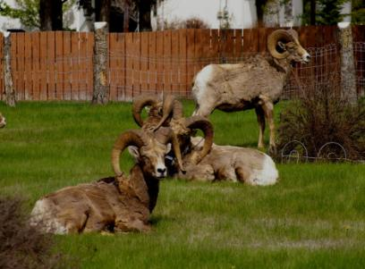
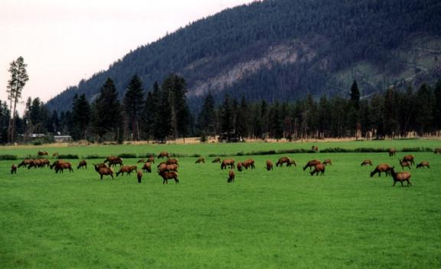
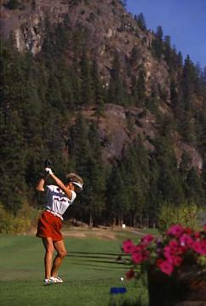
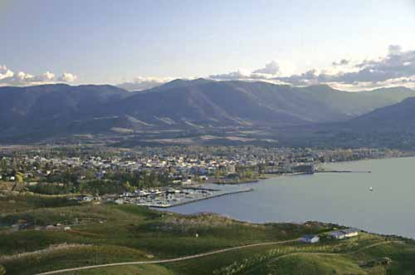
Increasing losses of wildlife habitat & forage supplies
Notes:
“Two key factors are contributing to the increasing fire risks. One is the population growth in areas where interface fires occur. The other is the build-up of combustible vegetation, a consequence of years of fire suppression activities.”
B.C. Auditor General’s Report (2001)

Slide 18
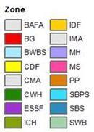
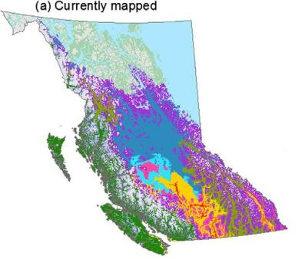
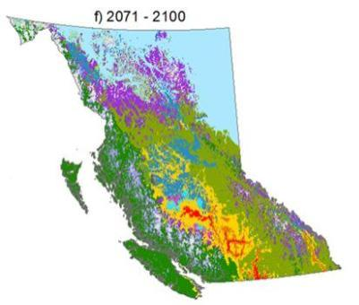
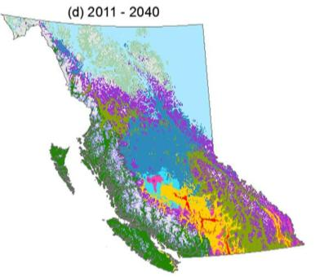
Climate change
Wang et. al. 2012

Slide 19
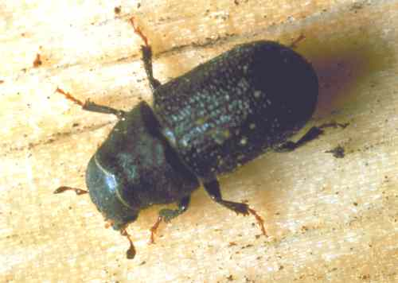
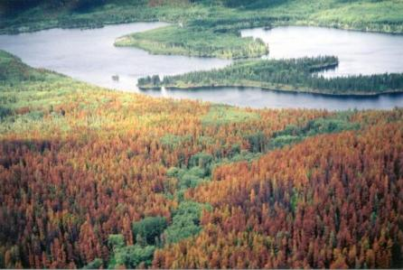
Canadian Forest Service
Unprecedented forest insect epidemics…..
Lorraine Maclauchlan, MoFR

Slide 20
Wildland fire management strategy
September 2010
“Climate change research indicates that the incidence and severity of wildfires will greatly increase over the next several decades.”

Slide 21
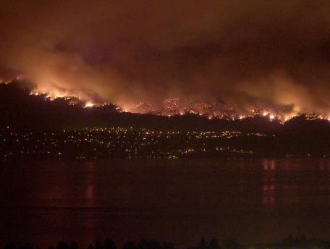
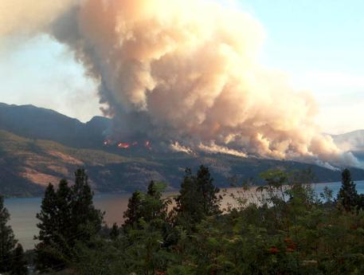
More frequent catastrophic
wildfires……

Slide 22
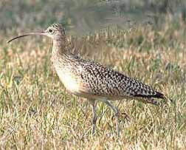
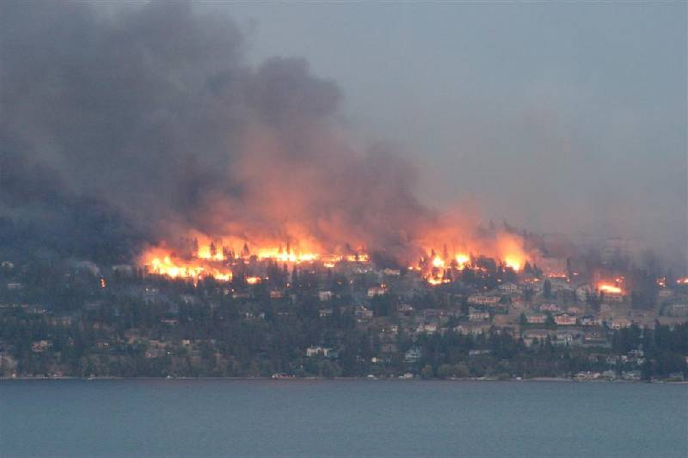
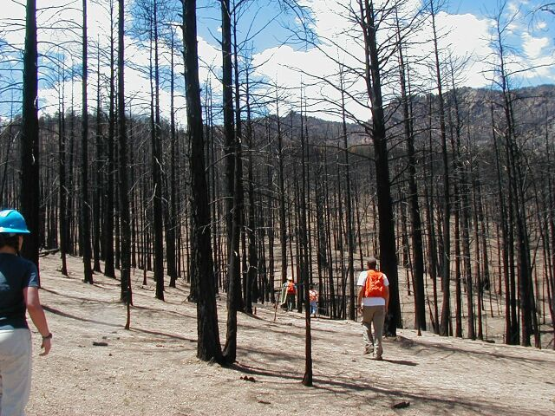
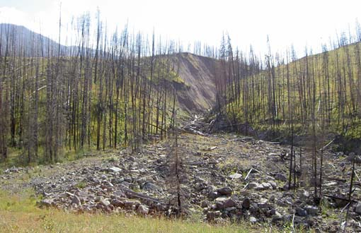
Habitat for Sensitive Species
Forest Communities
Soil Productivity
Drinking Water Sources

Slide 23
Ecosystem Restoration (ER):
“The process of assisting the recovery of resilience and adaptive capacity of ecosystems that have been degraded, damaged, or destroyed.

Slide 24
Ecosystem Restoration focuses on establishing the composition, structure, pattern, and ecological processes necessary to make terrestrial and aquatic ecosystems sustainable, resilient, and healthy under current and future conditions.

Slide 25
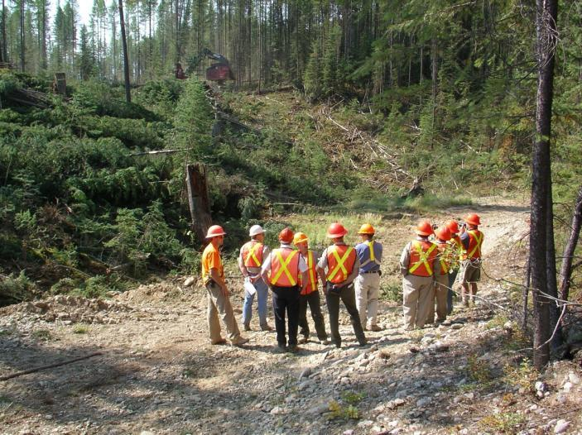


Slide 26
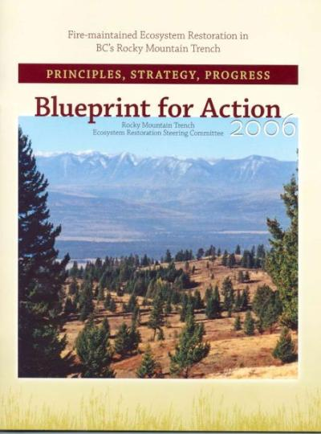
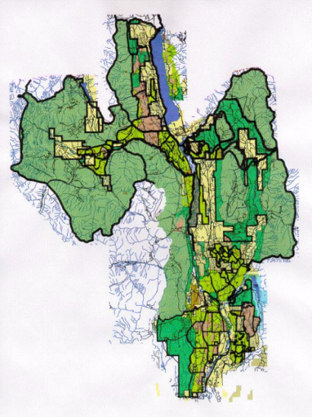
1:150,000

Slide 27
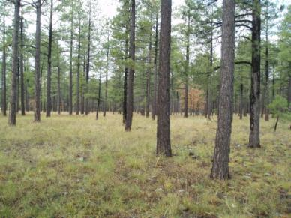
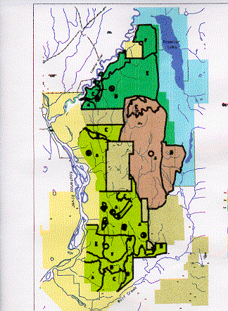
Develop a vision or desired future condition for your objective, what are you working towards?
  Almost always, this is a balance of ecological, economic and social factors.

Slide 28
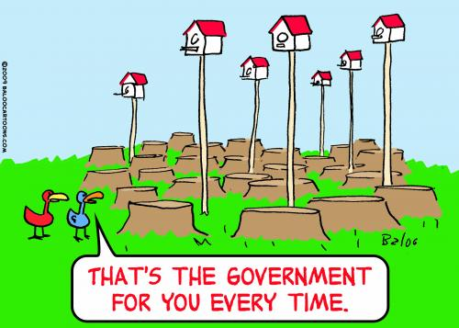
The ER Program is really getting some things done!

Slide 29
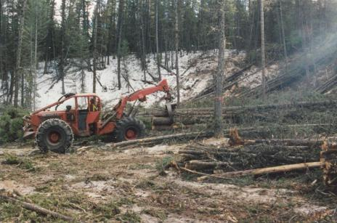
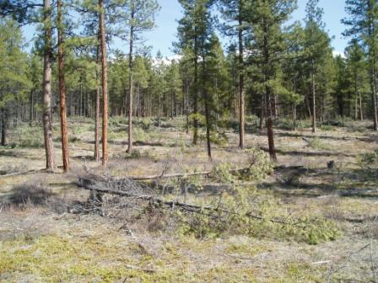

Conventional Harvesting
Slashing/Spacing
Prescribed Fire

Slide 30


Restoration
Before
July, 2003
July, 2006
-----
3 Months After Rx Fire

Slide 31

Maintenance
Before August, 2001
August, 2005
3 months After Rx Fire
Gail Berg

Slide 32


Understand your site
Downy Brome – Invasive
Silene spaldingii – Rare

Slide 33


Consider your site through time
Hazard abatement
Lewis’ woodpecker

Slide 34


Slide 35


Slide 36


Adequate planning is essential!!
There is no room for error! Training & experience are critical!

Slide 37


Aftermath of a burn – mortality of a few additional overstory stems, removal of ladder fuels, greater light to forest floor & reduced fire risk

Slide 38


Monitor your efforts
Ongoing pre & post-treatment monitoring is essential to ensure continuous improvement

Slide 39
BCPFC
BC Government: WMB planning, Fuels, ER, MOE, Air, Climate change, FFT
FNESS and BC First Nations Forestry Council
    Federal; Parks Canada, NR Canada, Canadian Wildlife Service
  Web site and communications
  MOU’s and policy, (Air quality, Highways)
  Training courses
    S-434 Ignitions
    S-435 Fire Planning and Operations
    S-580 Fire and Ecosystems
      After Action Reviews

Slide 40

Courtesy of Rexford RD, Kootenai NF
Direction of Spread
2005 Camp 32 Fire in NW Montana – field tested 150 stems/ha!!

Slide 41


Slide 42
Thanks for your time!

